Slide 1
MPCA LAB MINI PROJECT
PROJECT TITLE : FIRE ALARM SYSTEM USING GAS AND TEMPERATURE SENSOR
SECTION : I1
STUDENTS NAME : Vaibhav S
Tejashwini Hosamani
SRN’s : PES1UG19CS555
PES1UG19CS539

Slide 2
PROBLEM STATEMENT
FIRE ALARM SYSTEM USING GAS AND TEMPERATURE SENSOR

Slide 3
INTRODUCTION
Here we are going to design a Fire Alarm Circuit using a few electrical components like Temperature and Gas sensor using TinkerCad and interface it with Arduino.

Slide 4
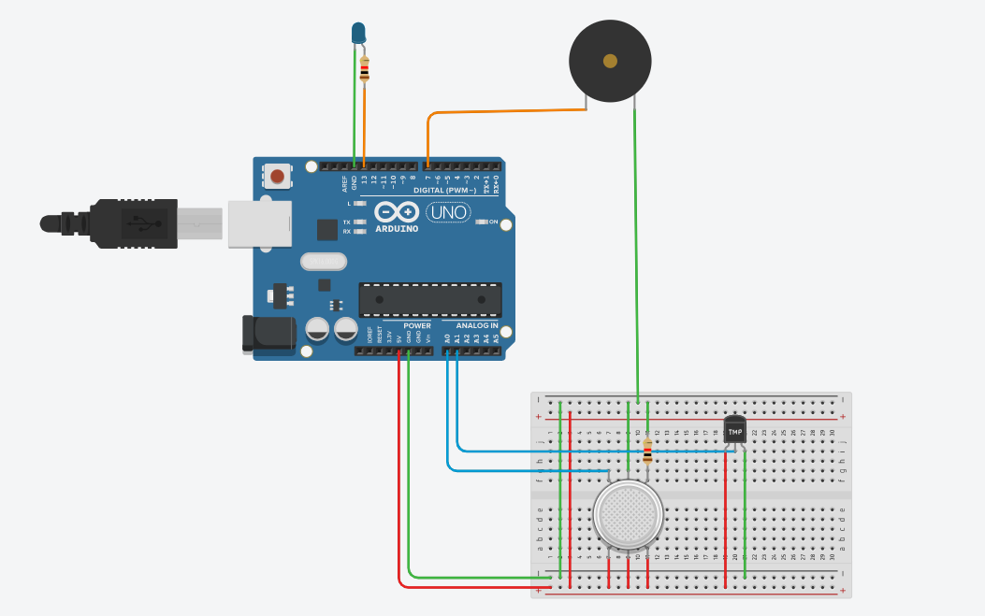
BLOCK DIAGRAM

Slide 5
REQUIRED COMPONENTS
Arduino Uno Board
Temperature Sensor
Gas Sensor
Resistors
Breadboard
LED
Piezo Buzzer
Wires

Slide 6
PROJECT DESCRIPTION/DEMONSTRATION
Here the blue wires indicates the input signal and orange wires indicates the output signal. The Gas Sensor is connected to A0 and Temperature Sensor is connected to A1. Similarly Piezo is connected to pin number 7 and LED is connected to pin number 13.

Slide 7
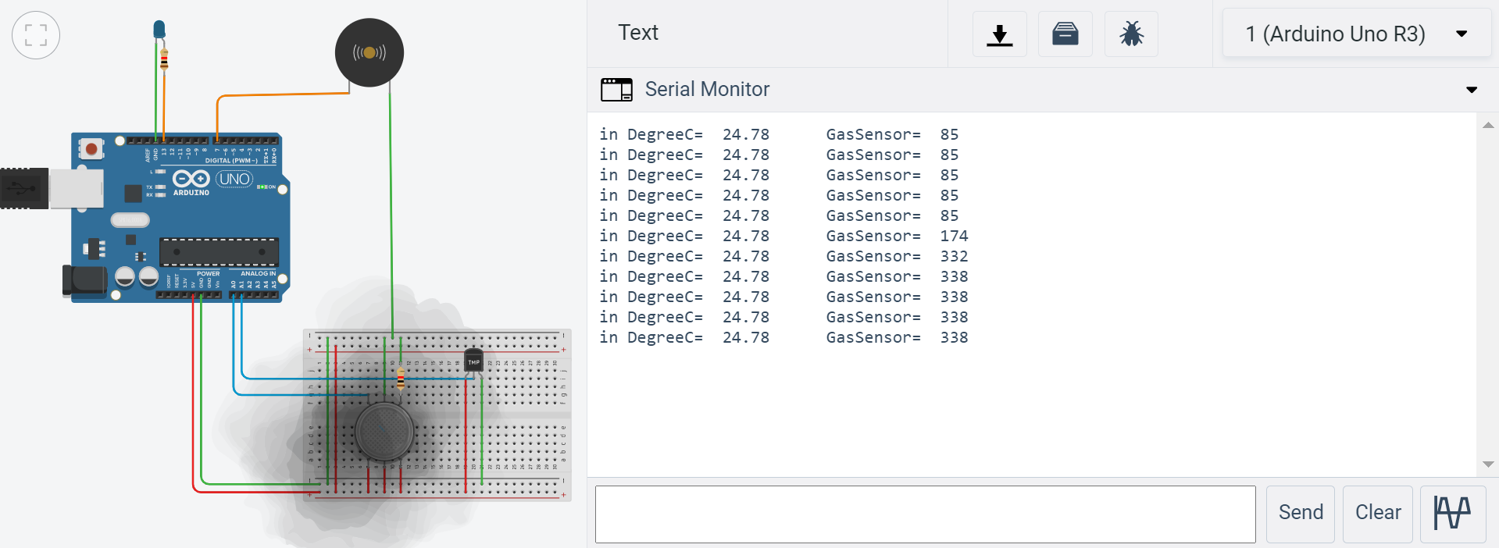
OUTPUT
Gas Sensor
When smoke is concentrated around the gas sensor, Piezo is set and it is buzzing.

Slide 8
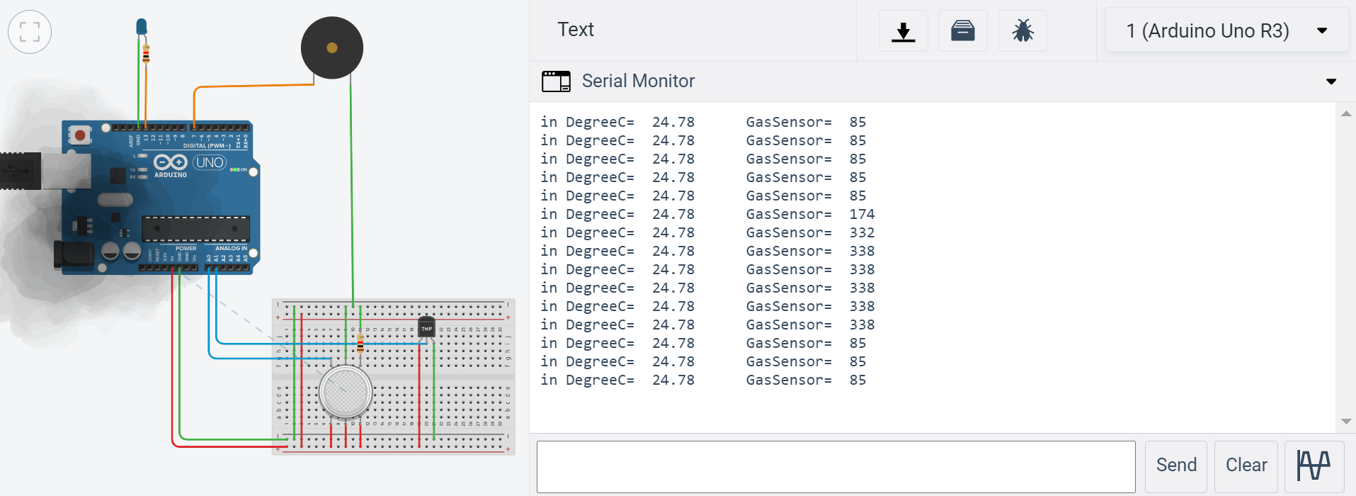
When smoke is moved away from gas sensor, Piezo stops buzzing.

Slide 9
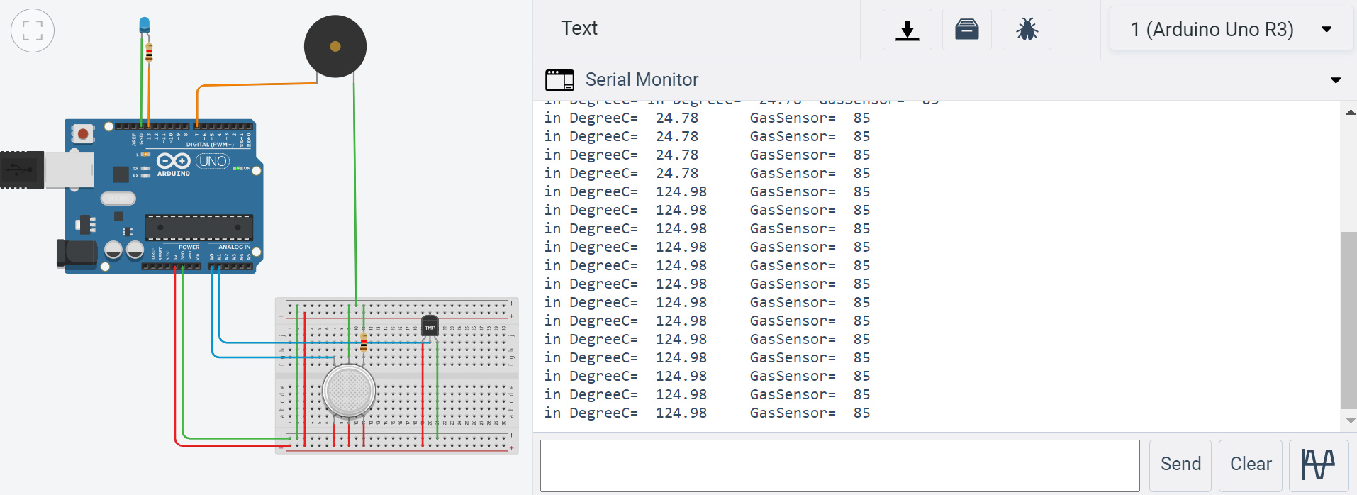
Temperature Sensor As temperature is increased, LED starts glowing.

Slide 10
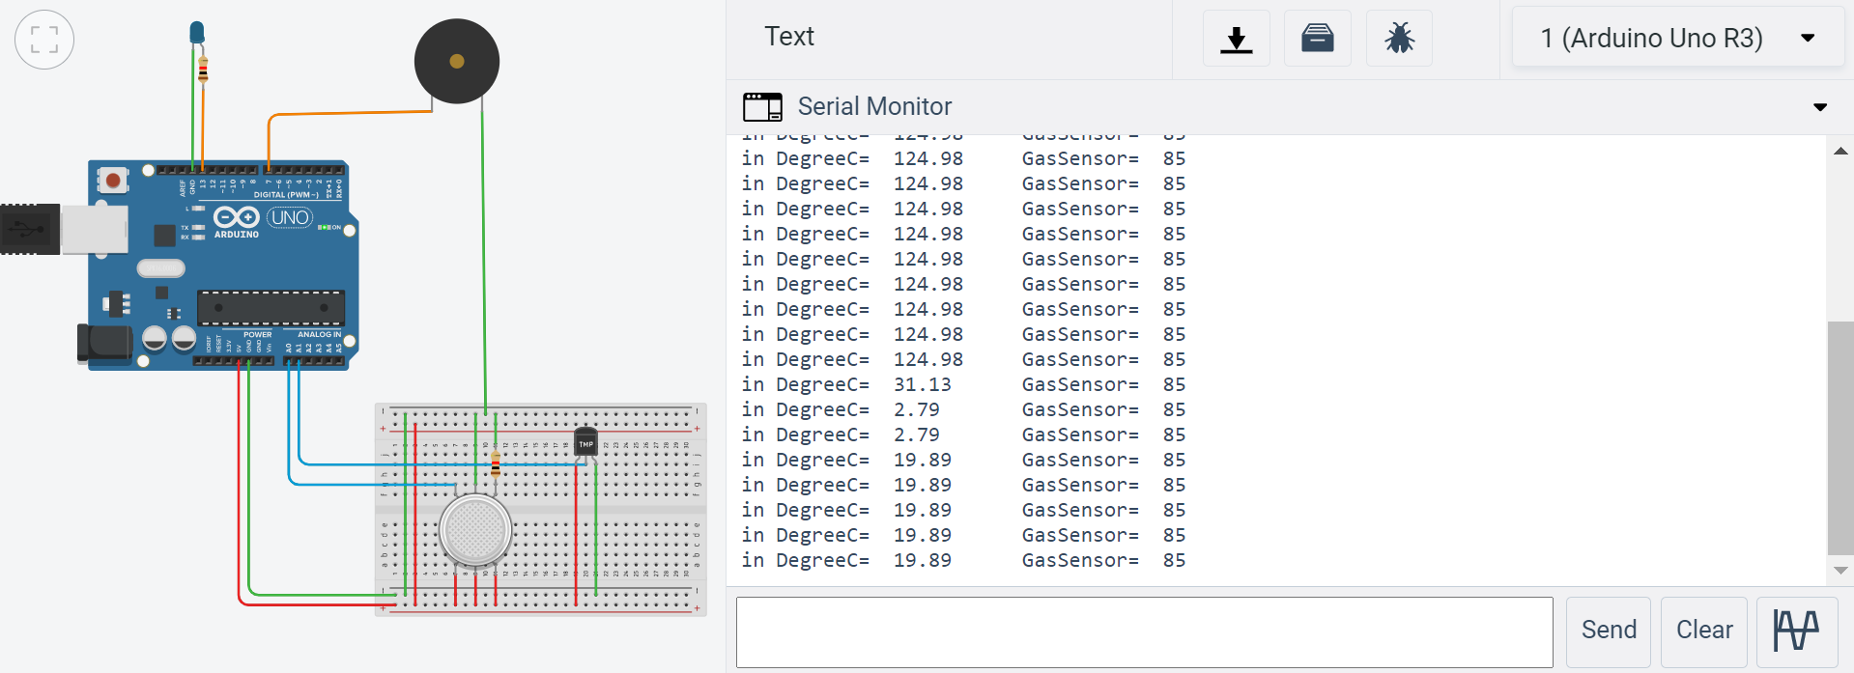
As temperature is decreased, LED stops glowing.

Slide 11
APPLICATIONS
A primary/secondary power supply, including batteries.
Smoke detector.
Audible alerts, flashing lights.
Pull stations, smoke alarms.
A control panel for constant monitoring and dispatch management.

Slide 12
REFERENCES(Website links, Books etc.)
https://www.learnelectronicsindia.com/post/fire-alarm-system-project-by-interfacing-arduino-with-temperature-gas-sensor-using-tinkercad
https://www.youtube.com/watch?v=fwwI4R_97DI&t=354s

Slide 13
Thank You ☺

